Slide 1
Backgammon - úrslit

Slide 2
Þátttakendur
Hópur B
BigBoy (hópur C)
Hópur D
Hópur H (Dúna)
Hópur J
pubStomper (hópur F)
Backgabomb (hópur G)

Slide 3
Stuttar kynningar á leikmönnum
BigBoy (hópur C)
Hópur H (Dúna)
pubStomper (hópur F)

Slide 4
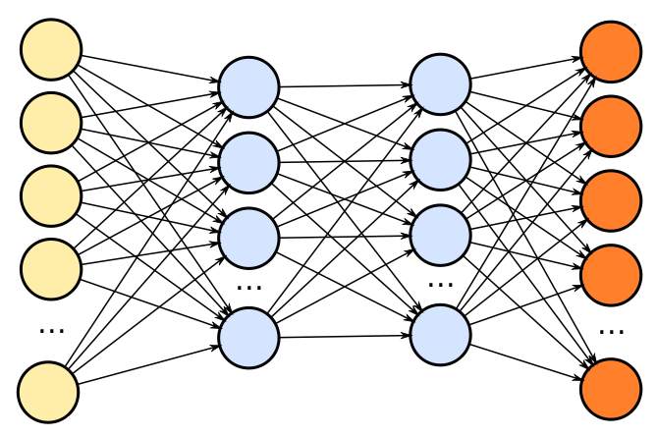
BigBoy
A greedy little bastard
Guðmundur Orri Pálsson
Stefán Gunnlaugur Jónsson
Vilhjálmur Kári Jensson

Slide 5
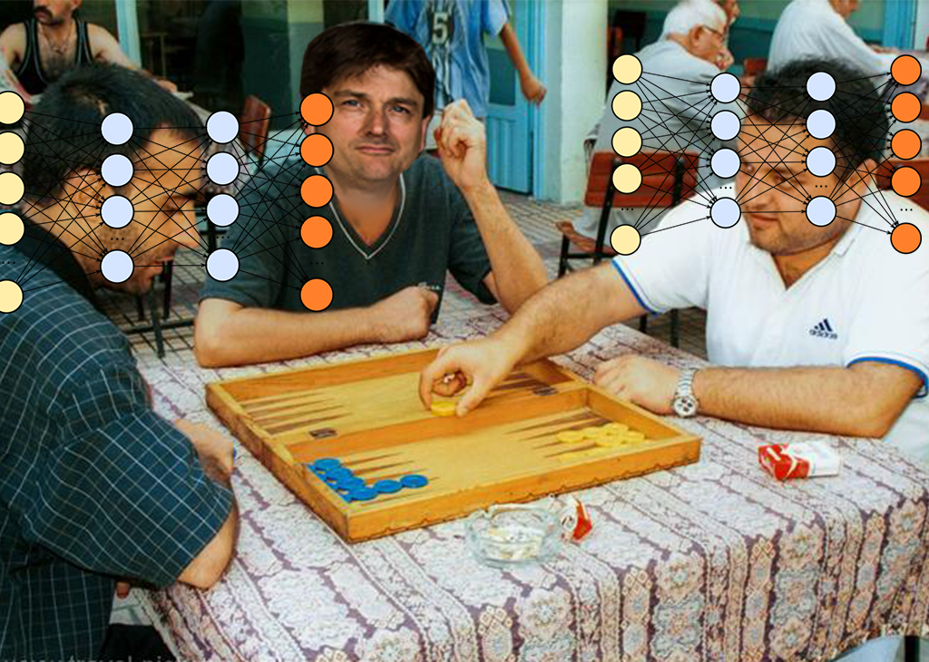
The story of BigBoy...
BigBoy is simple and greedy.
Hidden layer size of 40.
We had our own mini contest.
Lambda = 1, alpha = 0.001.
Trained 100.000 times vs. Lambda = 0.95, alpha = 0.001
Seperate neaural network for each player.
Notes:
BigBoy is in fact a basic Tesauro player. Simple and greedy. The input in the nueral net is a one hot encoded vector with a size of 868. For each square on the board can be 31 different possible outcomes (15 pieces for white, 15 pieces for black and 1 for if there is nothing on this square). There are total 28 squares so the length of the one hot encoded vector is 868.
Hidden layer size of 40.
We trained several different backgammon player, each with a different lambda and alpha value. BigBoy turned out to be the best player out of those players that we trained. We had our own mini contest. Lambda = 1, alpha = 0.001, trained 100.000 times against Lambda = 0.95, alpha = 0.001 Our implimentation has two seperate networks for player 1 and player 2

Slide 6
Mótaformat
Allir spiluðu við alla
Í hverju einvígi voru 1000 leikir
Tómas lofaði verðlaunum fyrir efstu 3 leikmennina
Efstu tveir spiluðu úrslitaleik
Horfum á hann á eftir

Slide 7
Round 1

Slide 8
Round 2

Slide 9
Round 3

Slide 10
Round 4

Slide 11
Round 5

Slide 12
Round 6

Slide 13
Stöðutaflan eftir 6 umferðir
Leikmaður | wins | losses | sit out
pubStomper | 5 | 0 | 1
H | 5 | 0 | 1
J | 3 | 2 | 1
Big Boy | 3 | 2 | 1
B | 2 | 3 | 0
Backgabomb | 0 | 5 | 1
D | 0 | 5 | 1

Slide 14


Slide 15
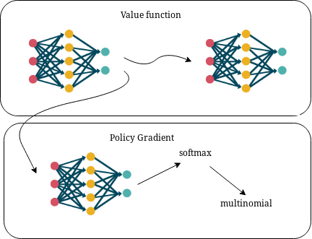
Statistics
Name: nn_pg_2 a.k.a. PubStomper
Feature vector: Hot-one 420-vector (28*15)
Layers: 200, 200 + 200-vector for output (each)
Temporal delay: 3 moves
Learning rate of value-function: 0.0001
Learning rate of policy-gradient: 0.002
Momentum: 0.9
Win-rate vs. random: 99% +

Slide 16
....

Slide 17
Round 7

Slide 18
Stöðutaflan eftir 7 umferðir
Leikmaður | wins | losses | sit out
H | 6 | 0 | 1
pubStomper | 5 | 1 | 1
Big Boy | 4 | 2 | 1
J | 3 | 3 | 1
B | 2 | 4 | 1
D | 1 | 5 | 1
Backgabomb | 0 | 6 | 1

Slide 19
pubEval
Leikmaður | win rate vs pubEval
H | 65%
pubStomper | 34%
Big Boy | 35%
J | 17%
B | 11%
D | 3%
Backgabomb | 1%
Leikmaður | wins | losses | sit out | sec/game
H | 7 | 0 | 1 | 0.043
pubEval | 6 | 1 | 1 | 0.030
pubStomper | 5 | 2 | 1 | 0.080
Big Boy | 4 | 3 | 1 | 0.047
J | 3 | 4 | 1 | 0.036
B | 2 | 5 | 1 | 0.050
D | 1 | 6 | 1 | 0.045
Backgabomb | 0 | 7 | 1 | 0.041

Slide 20
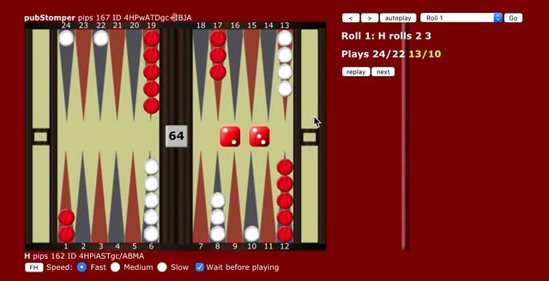
Úrslitaeinvígi

Slide 21
